Slide 1
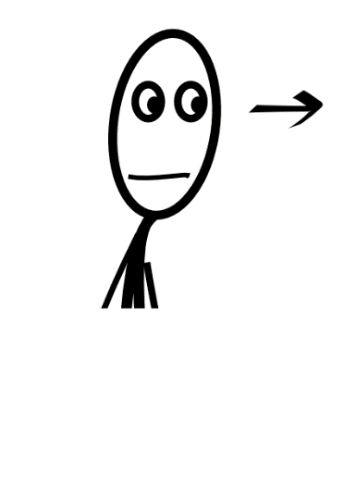
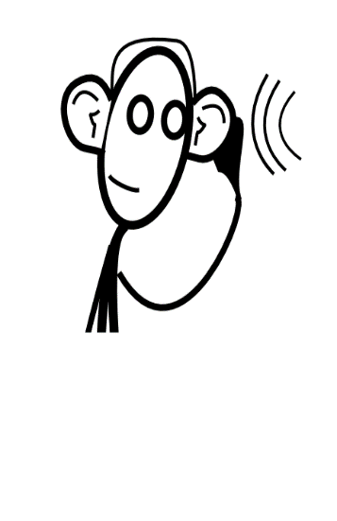
Aujourd’hui nous allons…
r_ _ _ _ _er
é_ _ _ _er
p_ _ _er
p_ _ _er
faire des gestes
Notes:
Part of essential classroom language – introduce pupils early to infinitive verbs by miming and saying these 4 skills that pupils are going to use in their learning today (and in lots of future lessons).
Ensure pupils know what they mean, and what ‘nous allons’ means.

Slide 2
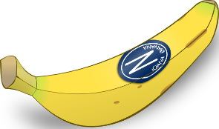
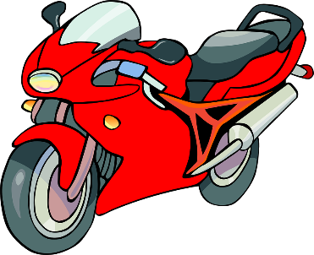
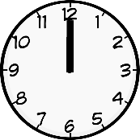
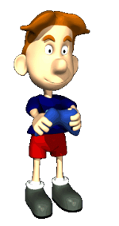
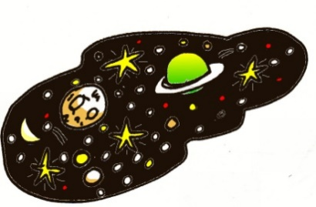
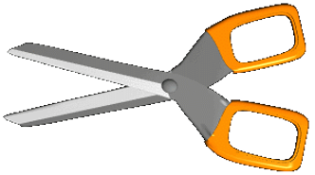
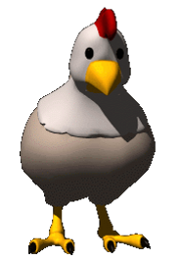
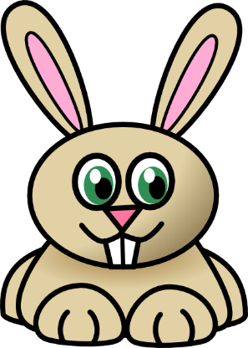
a
e
i
o
la banane
le cheval
midi
la moto
u
eu
(e)au
oi
l’univers
le jeu-vidéo
les ciseaux
le poisson
ou
on
in
la poule
le pont
le lapin
Notes:
Recap the five vowel phonics + gestures and then introduce the new seven dipthongs.
Most of these have a number that also rhymes / has the same dipthongs

Slide 3
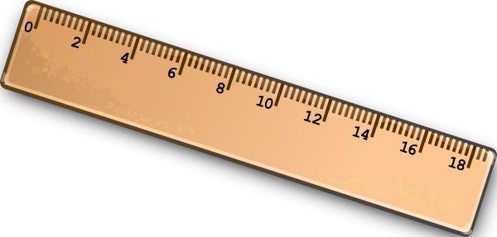
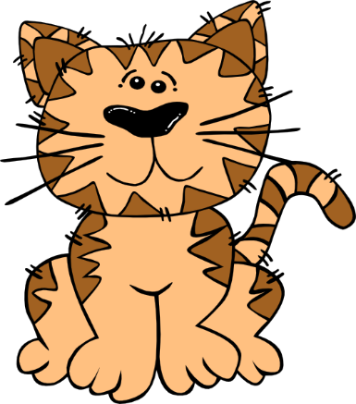
é
er
ez
et
le bébé
penser
dessinez
et
è
ê
ai
ei
la règle
la fête
le lait
treize
ch
th
en/an
un
lundi
mardi
mercredi
jeudi
vendredi
samedi
dimanche
le chat
le thé
l’enfant
lundi
Notes:
First 4 have the same sound:
é/er/ez/et Second 4 have the same sound
è/ê/ai/ei
ch th en/an/em/am
un
Gestures – obviously do any appropriate gestures but these are the ones that occur to me! le bébé – rocking an imaginary baby 3 times for le – bé – bé
penser – hold chin and look puzzled
dessinez – same gesture as in the classroom instructions less – hold imaginary pencil and sketch in the air
et – put first fingers of both hands together to make a plus sign
la regle – trace a ruler shape in the air using both hands (starting with fingers together in the middle and drawing away)
la fete – circle right arm above head twice as you say la fete – to denote excitement / celebration
le lait – hold hands in front in position as for milking a cow and pull down right hand on ‘le’ and left hand on ‘lait’
treize – flash up both hands together to show 10 and then 3 fingers of right hand only to give the extra 3
le chat – both hands either side of mouth and draw them away to show whiskers
le thé – make saucer with left hand and lift right hand from left palm towards mouth to gesture drinking
l’enfant – children pat own head as they are children
lundi – (first establish what lundi means as this is new vocabulary) – then do sign language for ‘lundi’ which is to make ‘L’ shape with left hand and use right hand to trace the ‘L’ from top to bottom as you say ‘lundi’
The audio is heard as the text & picture for each appear on each click.
You can also re-click on any word afterwards to hear the audio again.
Remaining sounds…
r
qu j/ge/gi gn
ille
eil/eille
ail/aille

Slide 4
Les consonnes
r = sound pushed to back of throat
ch = [sh]
j= [zsh]
qu=[k]
h = silent
ph = f
gn = almost in lasagne
s/t/n/x/d/p at the end of a word are usually silent.

Slide 5
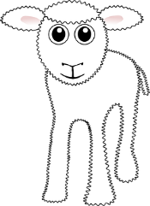
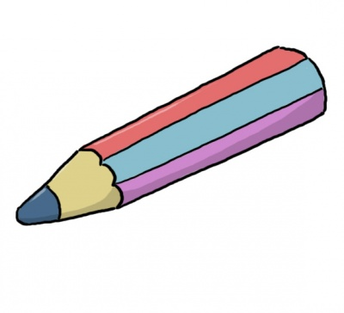
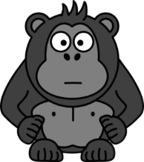
r
gn
qu
tion
ç
le crayon
l’agneau
la question
la natation
le français
ille
ail
eil
le gorille
le travail
le soleil

